Slide 1

WEYLAND ENERGY
Layout Evolution
Rev A → Rev C · Millbrook Solar & Storage · June 2026

Slide 2
Three revisions in five months
Revision | Date | MWp | Fenced area (ha) | Main change
Rev A | 2026-02-06 | 94.2 | 151 | Initial layout, 15 m footpath buffer
Rev B | 2026-04-14 | 88.6 | 146 | Footpath FP14 buffer 30 m, field 7 removed, Mill Lane setback 50 m
Rev C | 2026-06-05 | 85.0 | 142 | Submitted layout: 3 m hedgerow screen at receptors R04–R06, skylark plots
WEYLAND ENERGY · Millbrook – Layout Evolution
2

Slide 3
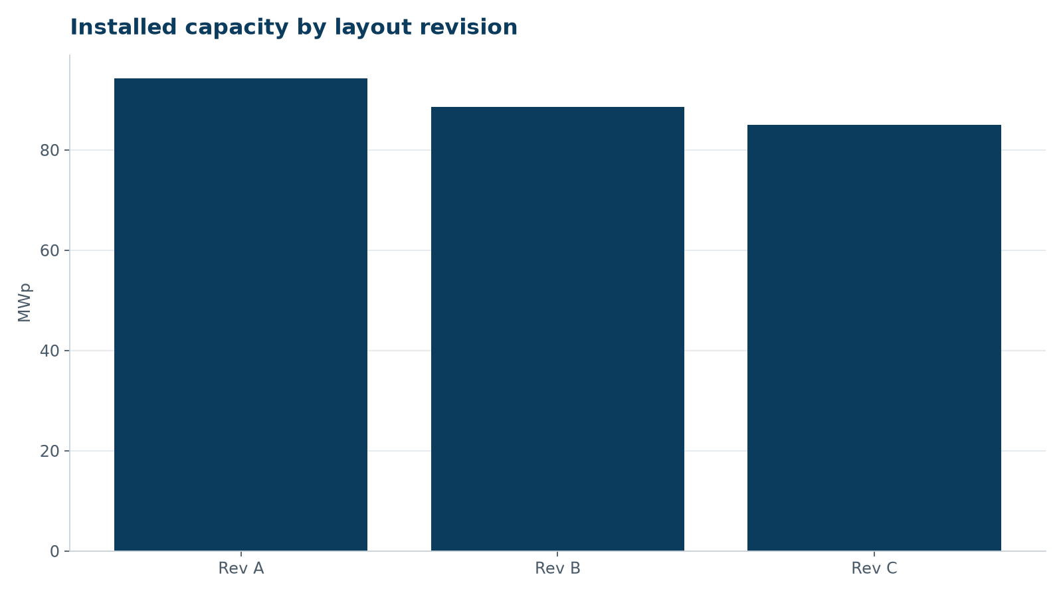
Capacity given up for acceptance
• Rev A → Rev C: -9.2 MWp (-9.8 %)
• Field 7 (5.6 MWp) removed to protect the church view
• Mill Lane setback 50 m and FP14 corridor 30 m
• Net effect on project IRR: -0.3 percentage points
WEYLAND ENERGY · Millbrook – Layout Evolution
3
Notes:
Amara asked whether this was worth it – the answer is yes: without it the parish council would object.

Slide 4

Footpath FP14 corridor
• 15 m → 30 m buffer
• Wildflower grassland both sides
• Open view to St Mary's Church kept
WEYLAND ENERGY · Millbrook – Layout Evolution
4

Slide 5

Mill Lane frontage
• 50 m setback from the lane
• 3 m native hedgerow screen at R04–R06
• No access for construction HGVs from the village side
WEYLAND ENERGY · Millbrook – Layout Evolution
5

Slide 6

BESS compound
• Moved 420 m from the nearest home
• 16 LFP containers, 0.9 ha
• Fire water containment 228 m³
WEYLAND ENERGY · Millbrook – Layout Evolution
6

Slide 7
Rev C is the submitted layout
85
40
142
+20 %
MWp solar on single-axis trackers
MWh battery storage
hectares site area
biodiversity net gain
WEYLAND ENERGY · Millbrook – Layout Evolution
7

Slide 8

WEYLAND ENERGY
Questions?
Sofie Lindqvist · Engineering

